Slide 1


Business Intelligence Project Presentation
Department of Artificial intelligence and data science
Academic Year: 2024 – 2025 (Even Semester)
Register Number : 927623ABAD023, 36, 47
Name : DHARSHINI K, GOPIKAMBAL N, KAARUNYA A S
Year : II
Semester : IV
Section : A
Date : 05-03-2025

Slide 2



Navigating the Shopper’s Trail
…

Slide 3

Introduction
In the modern retail industry, understanding shopper behavior is crucial for optimizing sales, enhancing customer experiences, and improving business decision-making.
The Navigating Retailer Shoppers Project focuses on analyzing shopper trends, purchase patterns, and store performance using IBM Cognos Analytics, a powerful business intelligence tool.

Slide 4
Problem Statement
Retailers often find it hard to understand customer behavior and make quick decisions because their data is scattered and not updated. They need a better way to track shopping trends and improve the customer experience.

Slide 5

ABSTRACT
1
Understanding Shopper’s Behavior
2
Data-Driven Insights
3
Visualization & Reporting
This dashboard analyzes customer journeys, tracking purchasing patterns, preferences, and interactions to optimize marketing strategies.
By integrating sales, customer demographics, and transaction history, analytics to enhance decision-making.
The dashboard presents key metrics such as sales trends, customer retention, and purchase frequency, enabling businesses to improve customer experience and increase revenue.

Slide 6


Data and Tools
Data
Tools and Technologies
Sales Transaction Data
Customer Demographics & Loyalty Data
Inventory & Stock Levels
Promotional & Discount Data
Peak Shopping Hours
HTML,CSS, for frontend
IBM Cognos Analytics as the core
platform

Slide 7


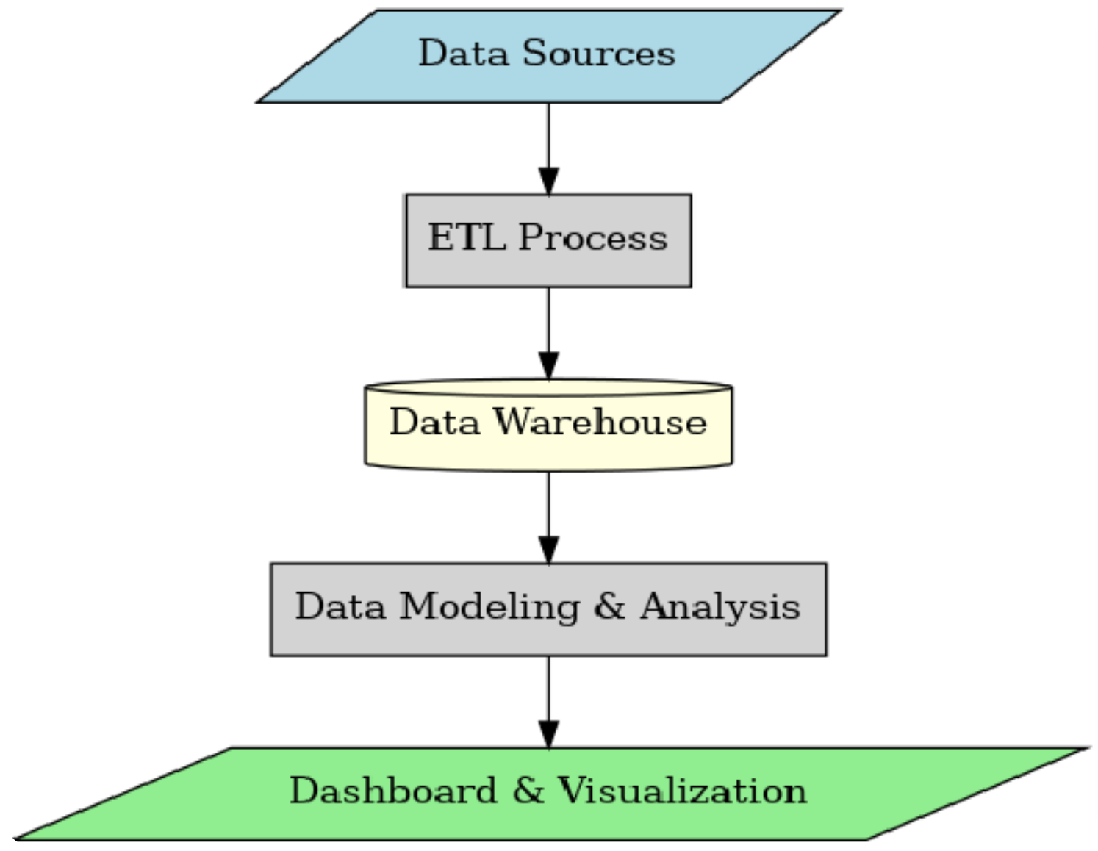
Proposed Architecture

Slide 8




Dashboard Design Plan
Key Performance Indicators (KPIs):
Types of Visualizations Planned:
Trend Line Charts for tracking sales patterns over time
Bar/Column Charts for comparing product performance
Gauge Charts for monitoring real-time key metrics
Interactive Dashboards with drill-down capabilities for deeper insights
Total Sales & Revenue
Peak Shopping Hours
Best-Selling Products
Customer Retention & Loyalty Metrics
Inventory Turnover Rate

Slide 9


Existing system
In traditional retail environments, decision-making relies on manual observations, POS (Point of Sale) data analysis, and historical sales reports. Retailers often face challenges in identifying peak shopping hours, understanding customer behavior, and optimizing product placements.
Manual Observations & POS Data Analysis
Lack of Real-Time Insights
Limited Customer Personalization
Inefficient Decision-Making
Fragmented Data Sources

Slide 10
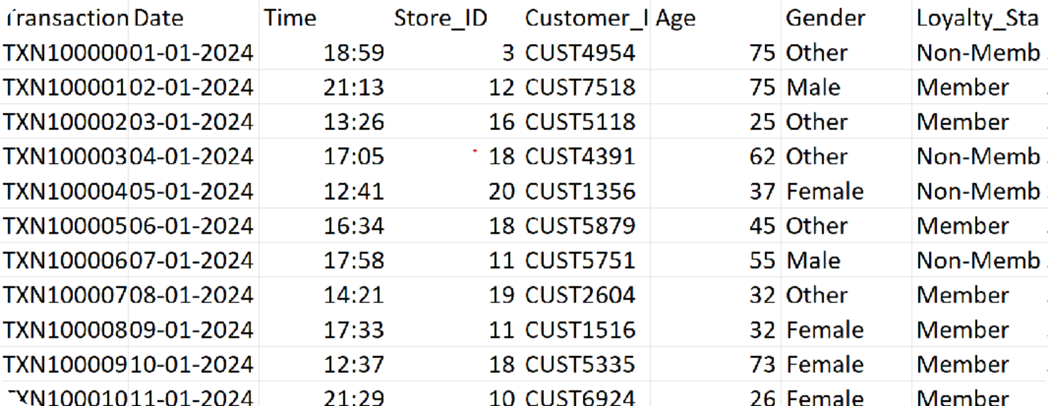
SAMPLE DATASET

Slide 11





METHODOLOGY
Data Collection
Collect shopper data from billing systems, loyalty cards, footfall counters, or online stores.
Data Preprocessing
Clean the data (remove errors, duplicates).
Organize it into useful categories like time, product, and customer type.
Data Analysis
Use tools like IBM COGNOS , Identify peak hours, popular products, loyal customers, etc.

Slide 12
METHODOLOGY
Dashboard Design
Create a user-friendly dashboard using IBM cognos include visuals like bar graphs, pie charts, and heatmaps.
Insight Generation
Extract meaningful patterns from the dashboard.
Suggest strategies based on the insights (e.g., increase staff at peak hours).
FINAL OUTPUT
Summarize findings.
Give practical suggestions to improve customer experience and sales.

Slide 13


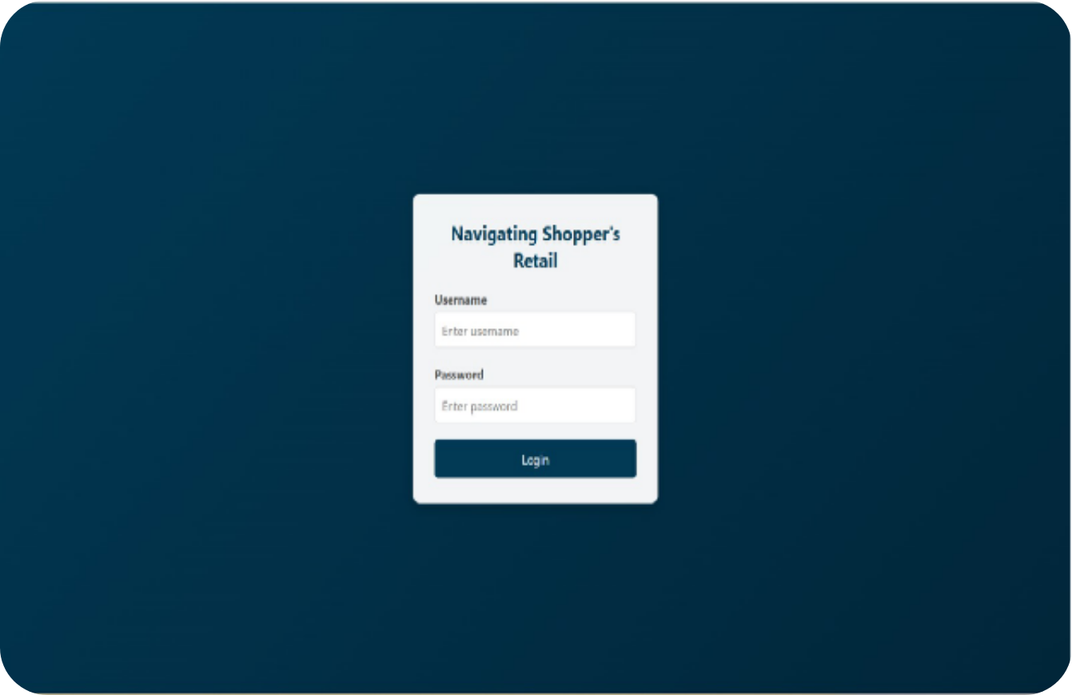
LOGIN PAGE

Slide 14


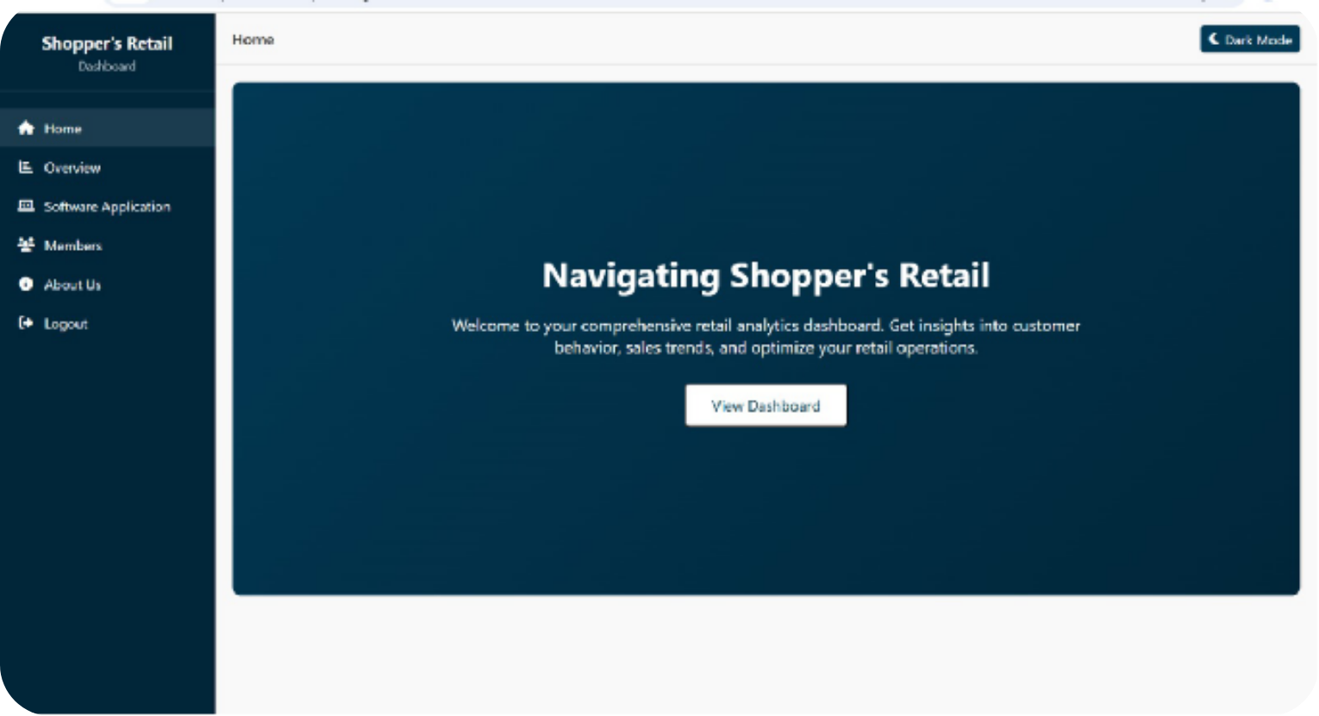
DASHBOARD

Slide 15


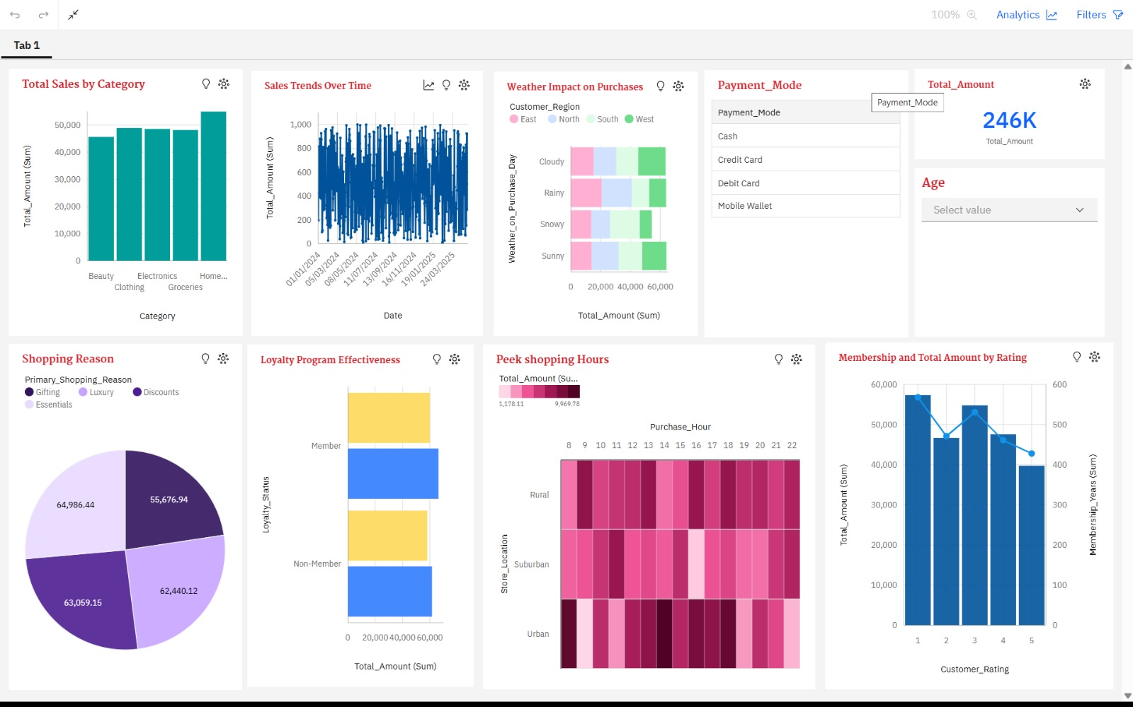
DASHBOARD

Slide 16


DASHBOARD
1
Total Sales by Category (Top-Left Chart)
2
Sales Trends Over Time (Top Middle Chart)
3
Weather Impact on Purchases (Top Middle-Right Chart)
Type: Vertical Bar Chart
Type: Line Chart
Type: Heatmap
Purpose: Displays how sales have fluctuated over time, based on daily total amount.
Purpose: Shows how different weather conditions affect purchasing behavior across customer regions.
Purpose: Shows the total sales amount for each product category.
Insight: Home category has the highest sales, followed by Groceries, Electronics, Clothing, and Beauty
Insight: Sales appear consistent across dates, with slight fluctuations—indicating regular customer activity.
Insight: Some weather conditions (like Sunny ) lead to higher purchase amounts in certain regions.

Slide 17





Advantages
📈 Smarter Inventory Management
2
💡 Enhanced Customer Understanding
1
3
🤝 Improved Customer Engagement
5
📊 Better Decision-Making
4
💸 Boosted Sales & Revenue

Slide 18
CONCLUSION
The "Navigating the Shopper’s Trail" project successfully demonstrates how IBM Cognos Analytics can transform raw retail data into actionable business intelligence. Through real-time dashboards, key performance indicators, and advanced visualizations, retailers gain deeper insights into customer behavior, product performance, and sales trends. These insights enable better inventory management and increased revenue.

Slide 19

Thank You

